Slide 1
Real-time recommendation system based on Storm
01123111 冯小川

Slide 2
Why use Storm?
A free and open source distributed realtime computation system.
Doing for realtime processing.
Scalable, fault-tolerant, guarantees your data will be processed.

Slide 3

Recommender system

Slide 4
Algorithm
Collaborative filtering
Content-based filtering
Hybrid recommender systems

Slide 5
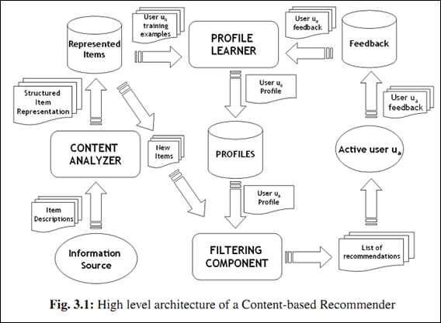
Content-based filtering

Slide 6
Work done
> Java environment installed.
> IntelliJ IDEA 14 installed.
> Strom cluster deployed.
> Papers Translation.
> Train Data collected.
> Algorithm research.

Slide 7
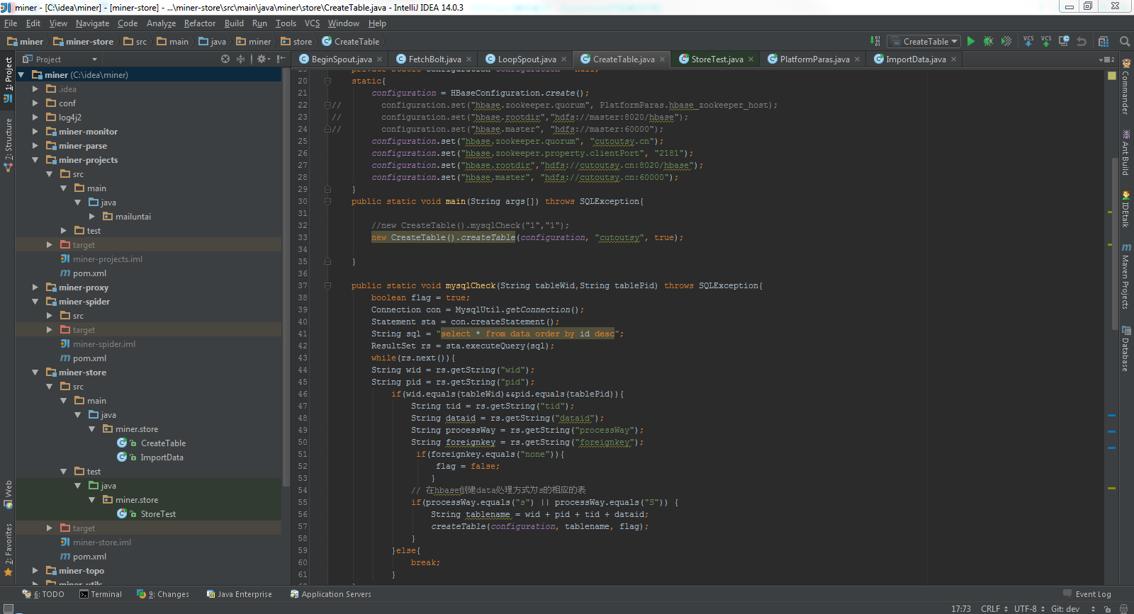

Slide 8
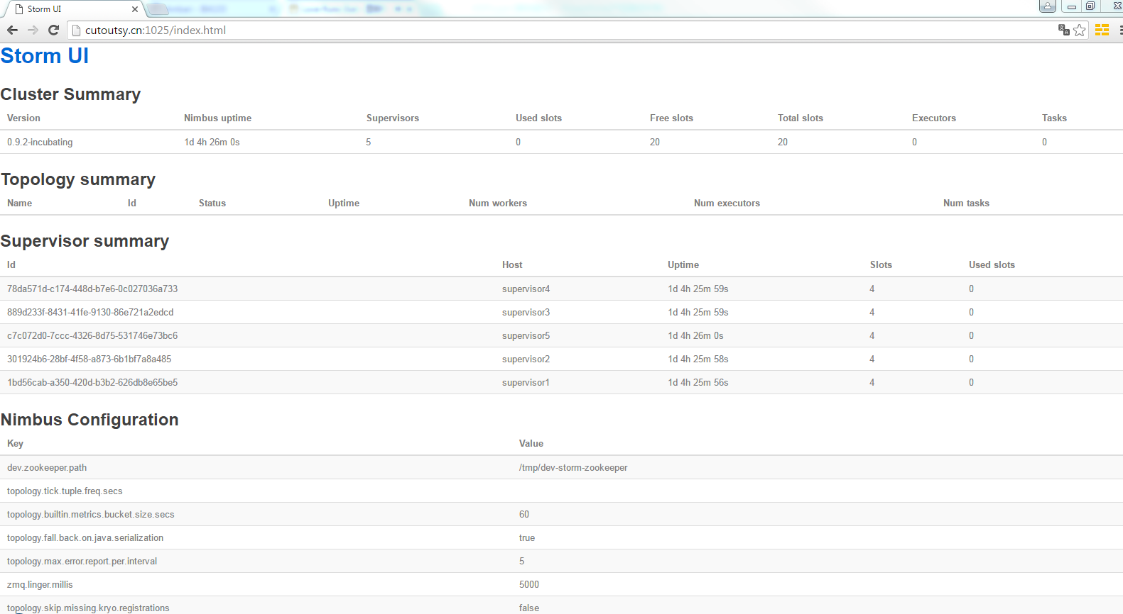

Slide 9
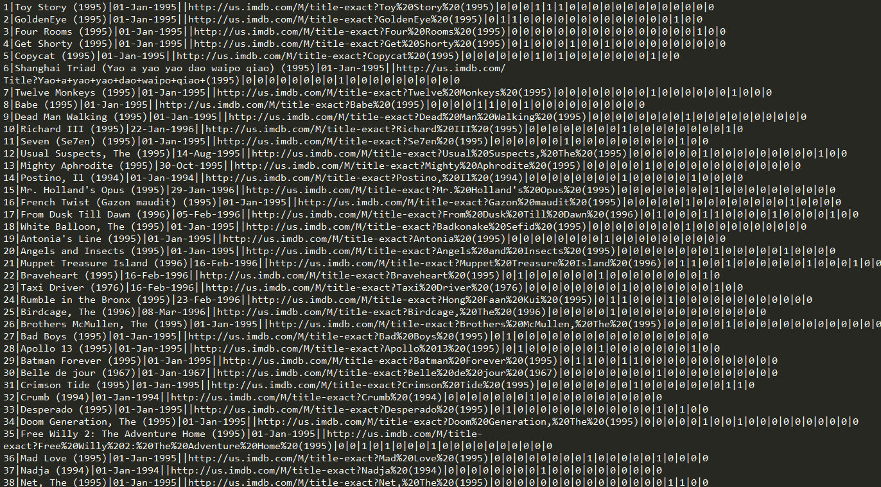

Slide 10
Next work
> Code、Test、Improve.
> Writing papers.

Slide 11
Thanks

